Slide 1
Distributive Law
Single Brackets
Notes:
Mr Parekh

Slide 2

Revision – Do Now
Multiplying Pronumerals.
$3x×y$
$4p×3q$
$−4p×2pq^{2}$
$4xy×−3yz$
Notes:
Set – Leave the questions on the board. Ask students to attempt the questions as they enter.

Slide 3
Learning Objectives
By the end of the class you will be able to:
Use distributive law to expand a single bracket.
Simplify algebraic equation by collecting like terms.

Slide 4
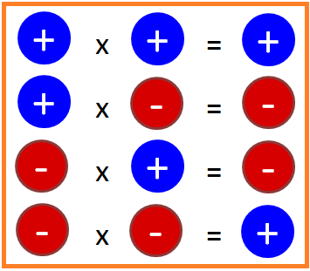
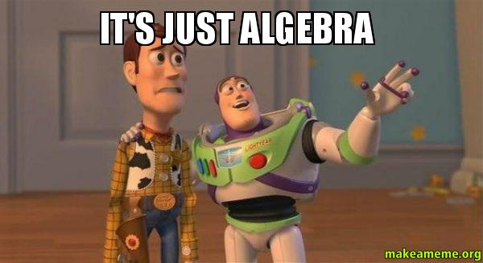
24
7
30
Distributive Law
Date:
EQ : How to do I use distributive law to expand the brackets?
Multiplying numbers with different signs.
Using Distributive Law to expand brackets
Multiply each term inside the bracket by the term outside the bracket.
+
ac
a (b + c)
=
ab
17
Notes:
Input

Slide 5
Guided Practice
1) Expand the following brackets:
(a)
3(2b - 5)
-
=
6b
15
(b)
x(5y + 2)
=
5xy
+
2x
(c)
3a(2b – 5)
6ab
=
-
15a
(d)
-5w(3w – 2m)
-15w²
=
+
10mw
Notes:
5

Slide 6
Independent Practice
Minimum
Dr Dwyer Textbook, pg 4, Exercise 1.3, Q 1- 9
Recommended
Dr Dwyer Textbook, pg 4, Exercise 1.3, Q 1- 15

Slide 7
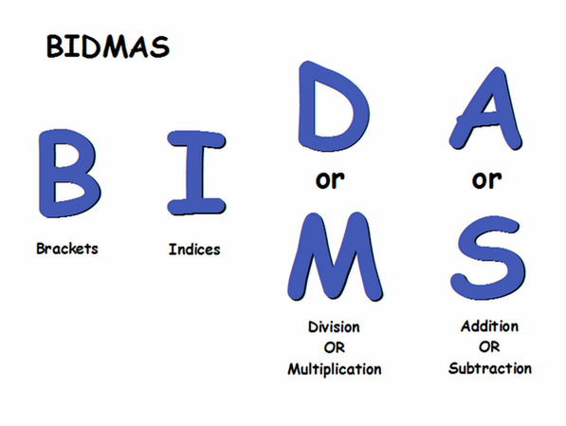
EXAMPLES – Notes Page
1) Expand the following brackets:
(e)
3(5a – 2) + 2(3a – 9)
-
6a
6
- 18
=
15a
+
21a
-
=
24
(f)
2(5x + 6) - 2(3x – 7)
+
6x
12
+ 14
=
10x
-
4x
=
+
26
Notes:
7
Can be used to model response before asking students to attempt Question 10-15 of Exerise 1.3

Slide 8
Closure
Complete the summary answering the EQ of the day.
Notes:
Can be a exit pass as well.

